Slide 1
Concurrent Big Data Processing Data Structures & Semantics
Idit Keidar

Slide 2
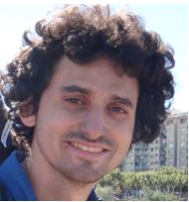
Shout Out
Fast Concurrent Data Sketches, PPoPP 2020 Arik Rinberg, Alexander Spiegelman, Edward Bortnikov, Eshcar Hillel, Idit Keidar, Lee Rhodes, Hadar Serviansky
Intermediate Value Linearizability, DISC 2020 Arik Rinberg and Idit Keidar (Best Student Paper)

Slide 3
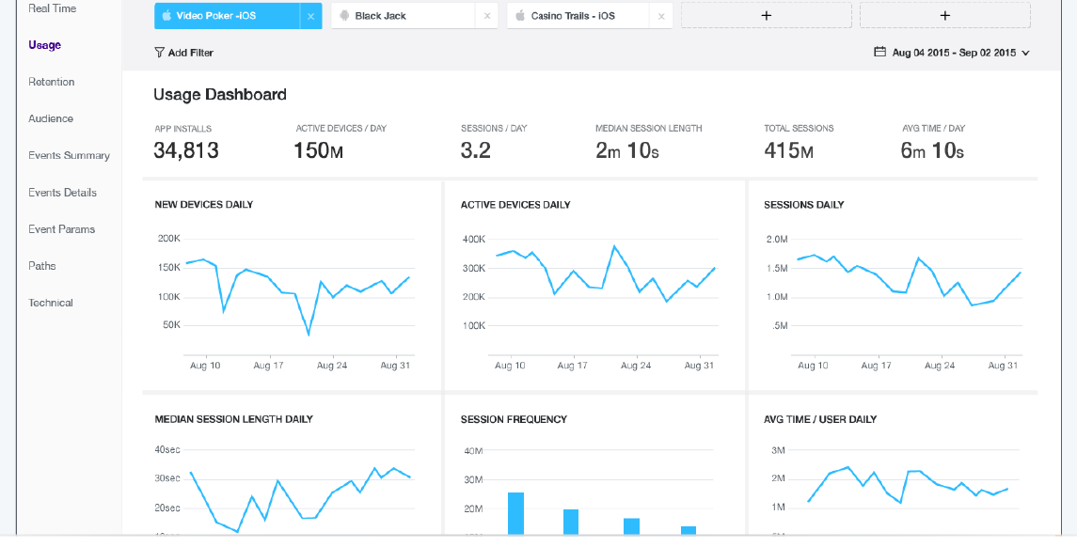
Roadmap
Concurrent data sketches:
Fast implementation
Correctness semantics
Real-Time Big Data Analytics
Data Sketch
Concurrent

Slide 4
Why New Semantics?
Amenable to efficient implementation
Linearizability is often too costly
Meaningful
Bound sketches’ estimation errors
Leverage what we know about the sequential case
Error analysis
Real-Time Big Data Analytics

Slide 5
Motivation: Massive Real-Time Analytics
Real-time reports ~830,000 mobile apps on ~1.6 billion user devices

Slide 6
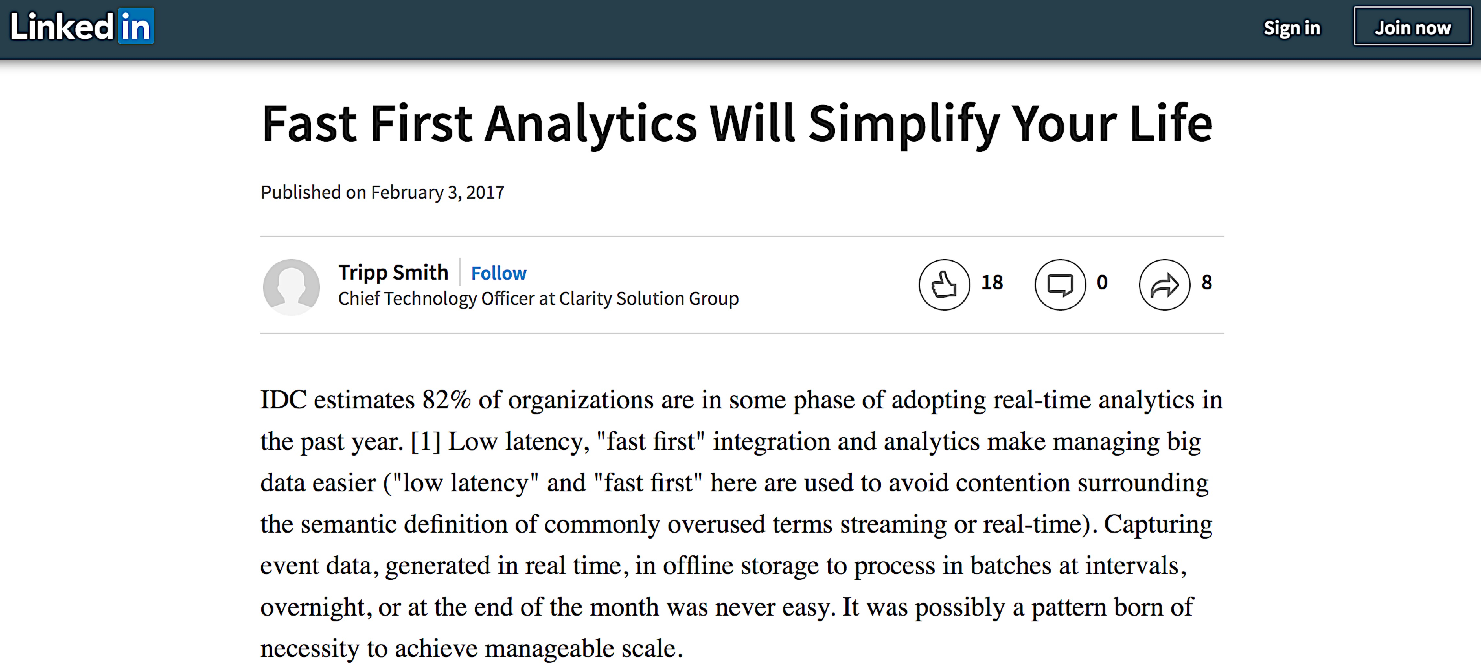

Slide 7
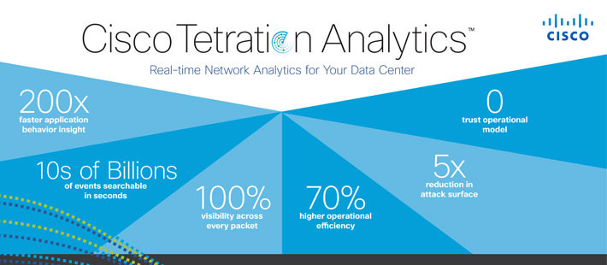
OLAP - Online Analytical Processing Examples

Slide 8
Motivation: Big Data Analytics & Monitoring
Real-Time Big Data Analytics

Slide 9
The Tool: Data Sketches
Real-Time Big Data Analytics
Data Sketch

Slide 10
Data Sketches: Lean & Mean Aggregation
Statistical summary of large stream
Estimates some aggregate
#uniques
quantiles
heavy-hitters
item frequencies
Fast
Small memory footprint
Widely-used

Slide 11
Real-Time Analytics – Where We Fit In
query
Data Sketch
update
Data Store
Content Processing

Slide 12
Example: Estimating the Number of Uniques
E.g., unique visitors to a web page
How many uniques?
Notes:
Israeli queue

Slide 13
$Θ$ Sketch: Basic Idea
Hash unique elements into [0,1] uniformly at random
0
1

Slide 14
$Θ$ Sketch: Basic Idea
Hash unique elements into [0,1] uniformly at random
How do we estimate how many there are?
Without keeping all of them in memory?
0
1

Slide 15
$Θ$ Sketch: Basic Idea
Hash unique elements into [0,1] uniformly at random
For a threshold $Θ$, $0<Θ≤1$
Keep elements with hashes smaller than $Θ$
In expectation, a $Θ$portion of the uniques in the stream
0
$$Θ$$
1

Slide 16
$KMV Θ$ Sketch [Bar-Yossef et al. 2002]
$Θ=k^{th}$minimum hash value seen (initially $Θ$= 1)
Estimate = $k/Θ$
Example: k=4
0
$$Θ=$$
1

Slide 17
$KMV Θ$ Sketch
$Θ=k^{th}$minimum hash value seen (initially $Θ$= 1)
Estimate = $k/Θ$
Example: k=4
0
$$Θ$$
1

Slide 18
$KMV Θ$ Sketch
$Θ=k^{th}$minimum hash value seen (initially $Θ$= 1)
Estimate = $k/Θ$
Example: k=4
0
$$Θ$$
1

Slide 19
$KMV Θ$ Sketch
$Θ=k^{th}$minimum hash value seen (initially $Θ$= 1)
Estimate = $k/Θ$
Example: k=4
0
$$Θ$$
1

Slide 20
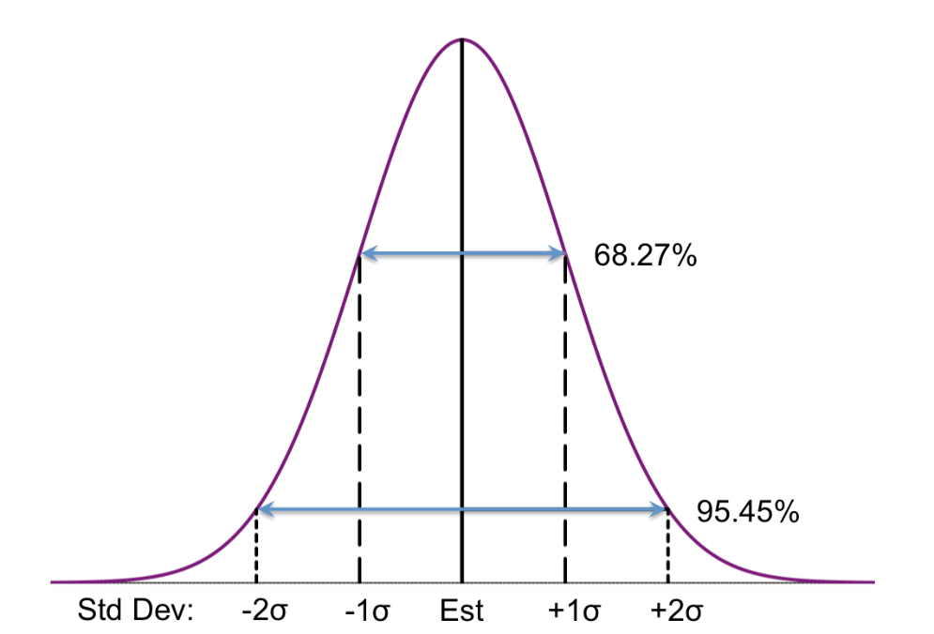
Sketches Are Approximate
Typically PAC (probably approximately correct)
Error at most $ε$with probability at least$1−δ$
With appropriately chosen parameters
Each sketch comes with its own analysis
KMV provides an estimate $\hat{e}$
E[$\hat{e}$] = $n$, the number of uniques
RSE[$\hat{e}$] = $\frac{1}{\sqrt{k−2}}$
RSE is the relative standard error = $\frac{σ}{n}$
[Bar-Yossef et al. 2002]

Slide 21
$Θ$ Sketches Are Fast
On incoming id
h = hash(id)
if h < $Θ$
add h to sketch
if |sketch| > k, remove largest
$Θ$ = largest hash in sketch
No else!
Once $Θ$is small, usually does nothing more

Slide 22
More Examples
Event counters
Quantiles – e.g., duration of 90th percentile of sessions
Item frequency – CountMin
Heavy hitters
Data Sketch
Notes:
We’ve explained sketches – there’s just one more thing we need to motivate

Slide 23
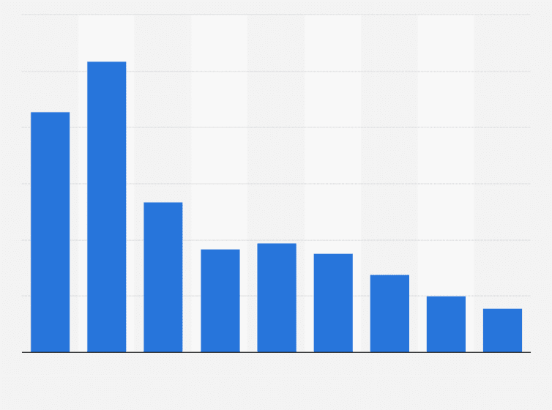
Hardware Trends
Multi-core servers
Performance via parallelism, not sequential speed
Cheaper DRAM
In-memory processing of bigger data
Average selling price of 1Gb DRAM 2009 to 2017
Notes:
OK, this is the last motivation slide

Slide 24
What and Why - Recap
What?
Concurrent data sketches, approximate counters
Why?
Online monitoring & analytics of big data streams
Why concurrent?
Today’s hardware: multi-core with larger RAM
Challenges
Efficient implementation
Meaningful semantics – leveraging what we know about the sequential case

Slide 25
Roadmap Recap
Concurrent data sketches:
Fast implementation
Correctness semantics
Real-Time Big Data Analytics
Data Sketch
Concurrent

Slide 26
Context: Open-Source DataSketches Library
Apache Incubating

Slide 27
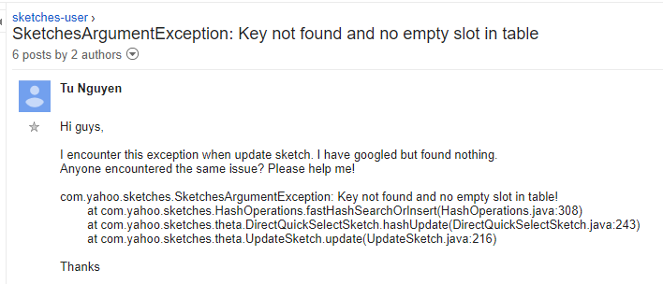
Today’s Sketches Aren’t Thread-Safe
https://github.com/apache/incubator-datasketches-java/issues/178#issuecomment-365673204

Slide 28
Challenge 1: Sketches Aren’t Thread-Safe
Need protection:
try {
lock (sketch)
sketch.update(...);
} finally {
unlock (sketch)
}
But locks are costly:
$Θ$Sketch Single-Thread Insertion Throughput

Slide 29
Challenge 2: Can’t Query While Updating
Current approach:
Use locks or
Update in epochs, query previous epoch
query
New Data Sketch
Old Data Sketch
update

Slide 30
Concurrent DataSketches

Slide 31
Concurrent Sketches - Goals
High throughput
Concurrent updates
Harness multi-cores for multi-threaded stream processing
Query freshness
Allow queries during updates
Ease-of-use
Library, not application, responsible for synchronization
Enjoy sketch’s benefits
Fast
Bounded estimation error
Small memory footprint

Slide 32
Concurrent Sketches: Generic Architecture
Sketch
queries
Your favorite sketch here
update

Slide 33
Concurrent Sketches: Generic Architecture
Global Sketch
Your favorite sketch here
queries
snapshot
More about that later …
merge
buffer (small sketch)
. . .
buffer (small sketch)
update
update

Slide 34
Example
$Θ$Global Sketch
merge
merge
buffer (size=2)
. . .
buffer (size=2)
update
update
Notes:
Example

Slide 35
What About Fastness?
$Θ$Global Sketch
if (hash(arg)) > $Θ$ skip …
merge
very fast once $Θ$ is small
buffer (size=2)
. . .
buffer (size=2)
update
But what is $Θ$ after buffer is emptied?
update
if (hash(arg)) > $Θ$ skip …

Slide 36
Optimizations
Problem: Missing critical information (e.g., $Θ)$
Solution: Piggyback sketch-specific information on existing generic synchronization
Problem: Thread is idle during propagation
Solution: Use double buffering

Slide 37
Space and Error
space & error bounds of sequential sketch
Global Sketch
snapshot
buffer (small sketch)
. . .
buffer (small sketch)
b extra space
b elements missed by query (per buffer)
Notes:
Small stream induce large relative errors

Slide 38
Bounding the Error in Small Streams
Use eager merge (no buffering) while stream < threshold
Global Sketch
merge
buffer (small sketch)
. . .
buffer (small sketch)
b elements missed by query (per buffer)
Out of how many ?

Slide 39
Keys to Performance
Minimize synchronization
Few fences
Synchronize only when buffer is filled/empty
Locality
Cache & NUMA friendly
Threads work in (mostly) unshared memory
But … share pertinent information
E.g., up-to-date $Θ$ for fast processing
Notes:
Sync – using an atomic bit once buffer is full
Locality – each buffer is per thread
Share Info – e.g., local sketches use global Theta

Slide 40
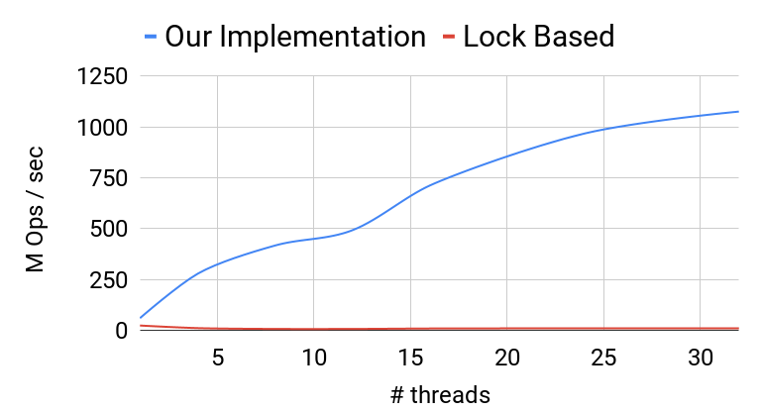
Update Throughput
Same performance for all buffer sizes b.
Notes:
Current practice is with lock

Slide 41
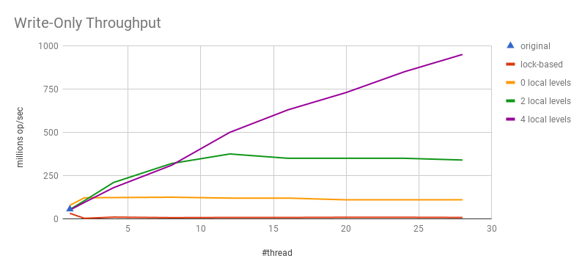
Another Example: Quantiles Sketch
b=4*4096
Throughput (million ops\ sec)
b=4096
b=2*4096
lock-based
Here, the buffer size b matters.

Slide 42
Proof Overview
We show that
our generic algorithm
instantiated with a composable sketch
satisfies strong linearizability [Golab et al. ]
wrt an r-relaxation [Henzinger et al.] of
the sequential specification derived from the sequential sketch
for r = 2Nb; N = #threads, b = buffer size
We then analyze the error of the relaxed specification
By strong linearizability, this is the error of our sketch!
Notes:
Important, we prove correctness w.r.t to a relaxed seq specification and bound the error.

Slide 43
Analyzed Error of Concurrent $Θ$ sketch
Relative error is similar
Mean is shifted

Slide 44
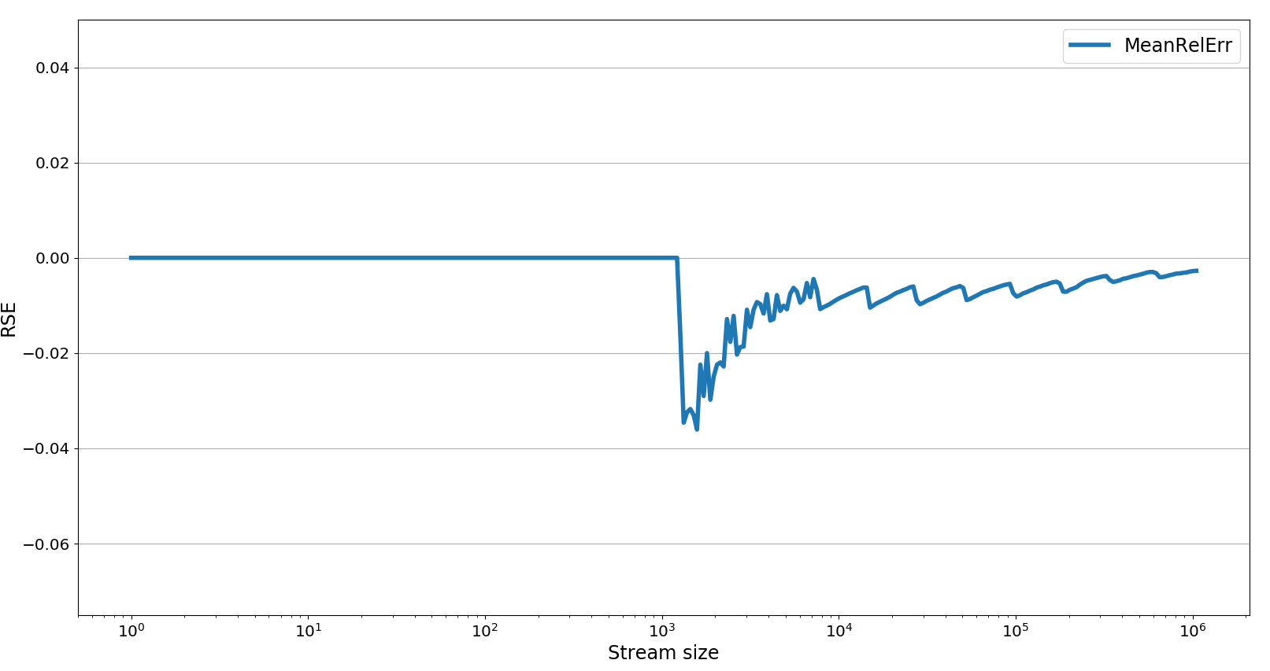
Empirical Evaluation of Relative Error
Eager propagation ends here

Slide 45
Interim Summary: Fast Concurrent Sketches
Generic solution based on composable sketches
Rigorous correctness proof using relaxed consistency
High throughput via concurrent updates
Query freshness
Allow queries during updates
Ease-of-use
Library responsible for synchronization
Enjoy sketches’ benefits
Fast
Bounded estimation error
Small memory footprint
Now Available

Slide 46
Roadmap Recap
Concurrent data sketches:
Fast implementation
Correctness semantics
Real-Time Big Data Analytics
Data Sketch
Concurrent

Slide 47
Wait, didn’t you just say you proved correctness?
Something about r-relaxed strong linearizability?

Slide 48
Concurrency on the Global Sketch Revisited
Global Sketch
queries
snapshot
merge
The global sketch is strongly linearizable
The r-relaxation only arises due to buffering (local sketches)
In general, this requires atomic snapshots
In the $Θ$sketch, snapshots are cheap
Alas, this is not always the case
Told ya I’d say more about that.

Slide 49
Example: CountMin Sketch [Cormode and Muthukrishna, 2005]
Estimates item frequency
$$w$$
$$h_{1}$$
$$h_{2}$$
$$h_{3}$$
$$d$$
$$h_{4}$$
$$h_{d}$$
$$h_{1},…,h_{d}:Σ↦[w]$$

Slide 50
Example: CountMin Sketch
$$w$$
$$h_{1}$$
1
 | 3
1
 |  | 4
 |  |  | 2
$$h_{2}$$
$$a$$
$$h_{3}$$
$$d$$
$$h_{4}$$
$$h_{5}$$
$$h_{1},…,h_{d}:Σ↦[w]$$

Slide 51
Example: CountMin Sketch
$$w$$
$$h_{1}$$
1
 | 3
1
 |  | 4
 |  |  | 2
$$h_{2}$$
$$a$$
$$h_{3}$$
$$d$$
$$h_{4}$$
$$h_{5}$$
$$h_{1},…,h_{d}:Σ↦[w]$$

Slide 52
Example: CountMin Sketch
$$w$$
$$h_{1}$$
1
 | 3
1
 |  | 4
 |  |  | 2
$$h_{2}$$
$$a$$
$$h_{3}$$
$$d$$
$$h_{4}$$
$$h_{5}$$
$$h_{1},…,h_{d}:Σ↦[w]$$

Slide 53
Example: CountMin Sketch
$$w$$
$$h_{1}$$
2
 | 3
1
 |  | 4
 |  |  | 2
$$h_{2}$$
$$a$$
$$h_{3}$$
$$d$$
$$h_{4}$$
$$h_{5}$$
$$h_{1},…,h_{d}:Σ↦[w]$$

Slide 54
Example: CountMin Sketch
$$w$$
$$h_{1}$$
2
 | 4
2
 |  | 5
 |  |  | 3
$$h_{2}$$
$$a$$
$$h_{3}$$
$$d$$
$$h_{4}$$
$$h_{5}$$
$$h_{1},…,h_{d}:Σ↦[w]$$

Slide 55
Example: CountMin Sketch
$$w$$
$$h_{1}$$
2
 | 4
2
 |  | 5
 |  |  | 3
$$h_{2}$$
$$a$$
$$h_{3}$$
$$d$$
$$h_{4}$$
$$h_{5}$$
$$h_{1},…,h_{d}:Σ↦[w]$$

Slide 56
Example: CountMin Sketch
$$w$$
$query\left( a \right)$ $returns:$
$${\min\left\{h_{i}\left( a \right)\right\}}_{i=1}^{d}$$
$$h_{1}$$
2
 | 4
2
 |  | 5
 |  |  | 3
$$h_{2}$$
$$h_{3}$$
$$d$$
Returns 2
$$h_{4}$$
$$h_{5}$$
$$h_{1},…,h_{d}:Σ↦[w]$$

Slide 57
CountMin Sequential Error Bounds
Consider a query invoked after N updates
Let $f\left(a\right)$ denote the frequency of a in these updates
$query\left(a\right)$ returns an estimate $\hat{f}\left(a\right)$ of $f(a)$
For desired parameters $ε, δ,$
CountMin’s parameters w and d can be chosen so that
$f\left(a\right)≤\hat{f}\left(a\right)$, and with probability at least $1−δ$:
$\hat{f}\left(a\right)≤f\left(a\right)+εN$
[Cormode and Muthukrishna, 2005]

Slide 58
What About Concurrency?
Can a query just read the counters?
update
update
update
read $h_{1}$
read $h_{2}$
read $h_{3}$
read $h_{4}$, $h_{5}$
query( )

Slide 59
What About Concurrency?
Can a query just read the counters?
not linearizable
update
update
update
read $h_{1}$
read $h_{2}$
read $h_{3}$
read $h_{4}$, $h_{5}$
query( )
Might return $\hat{f}\left(a\right)$that does not occur in any linearization

Slide 60
What About Concurrency?
Can a query just read the counters?
not linearizable
inc $h_{1}$
inc $h_{2}$
update
read $h_{1}$
read $h_{2}$ - $h_{5}$
query( )
query( )

Slide 61
Problem?
We required the shared global sketch to be strongly linearizable
This makes it indistinguishable from an atomic variable
And so preserves the error bounds of the sequential sketch
Note: this holds for any sequential sketch
But … requires an atomic snapshot (costly)

Slide 62
But …
What if a query just reads the counters?
update
update
update
query(a)
If the query atomically happens here, it returns ${\hat{f}}^{s}\left(a\right) so that$
$$f^{s}\left(a\right)≤{\hat{f}}^{s}\left(a\right)$$

Slide 63
But …
What if a query just reads the counters?
update
update
update
query(a)
If the query atomically happens here, it returns ${\hat{f}}^{e}\left(a\right) so that$
$${\hat{f}}^{e}\left(a\right)≤f^{e}\left(a\right)+εN^{e} \text{with} \text{probability} \text{at} \text{least} 1−δ$$

Slide 64
But …
What if a query just reads the counters?
update
update
update
query(a)
All counters are monotonic, so the query returns $\hat{f}\left(a\right)$
$${\hat{f}}^{s}\left(a\right)≤\hat{f}\left(a\right)≤{\hat{f}}^{e}\left(a\right)$$

Slide 65
So …
The error remains bounded without a snapshot
$f^{s}\left(a\right)≤{\hat{f}}^{s}\left(a\right)$
${\hat{f}}^{e}\left(a\right)≤f^{e}\left(a\right)+εN^{e}$ $\text{with} \text{prob} ≥1−δ$
${\hat{f}}^{s}\left(a\right)≤\hat{f}\left(a\right)≤{\hat{f}}^{e}\left(a\right)$
We get: $f^{s}\left(a\right)≤$ $\hat{f}\left(a\right)≤$ $f^{e}\left(a\right)+εN^{e}$ $\text{with} \text{prob} ≥1−δ$
The item’s frequency at the time when the query begins
The item’s frequency at the time when the query ends
The stream size at the time when the query ends

Slide 66
OK, so a concurrent CountMin sketch does not need to be linearizable, but can you specify what it does need to ensure?
Better yet, can you specify a generic property that applies to many sketches?

Slide 67
Intermediate Value Linearizability (IVL)
A correctness criterion for concurrent quantitative objects
A query returns a value from a totally ordered domain
E.g., sketches, counters
Cheaper than linearizability
Inherently in some cases (see Arik’s talk)
Preserves the error bounds of the sequential object
Enforces (non-relaxed) linearizability in sequential executions, allows more freedom in concurrent ones
A local property (composable)

Slide 68
IVL – Simple Example
Every query’s return value is bounded between two legal values that can be returned in linearizations
counter=17
add(4)
add(3)
counter=24
query
May return any value between 17 and 24

Slide 69
$(ε,δ)$-Bounded Objects
For an ideal value $v$, a query returns a value $\hat{v}$ such that
with probability at least $1−δ$/2: $\hat{v}≥v−ε$
and
with probability at least $1−δ$/2: $\hat{v}≤v+ε$
Many examples, including $Θ,$Quantiles, CountMin, …

Slide 70
Our Main Theorem
An IVL implementation of a sequential $(ε,δ)$-bounded object is a concurrent $(ε,δ)$-bounded object.

Slide 71
To Conclude
Big data analytics has big demands
Memory is getting bigger – more data can be analyzed in memory
CPUs are not getting faster – need to harness multi-cores
Concurrent processing challenges:
Efficiency – minimize synchronization, share pertinent information
Correctness – analyze impact of concurrency on error
Our contributions:
Framework for fast concurrent sketches
Correctness semantics with guaranteed error bounds
Thank you!

